Slide 1

4 bit Hex Encryption & Decryption
Presented By:
21BCE509
Jaimin Babaria

Slide 2
Introduction
T
🠺
🠺
My project does the encryption of a 4 bit hexa-decimal message using public key and private key infrastructure and decrypts the message at the receiver’s end

Slide 3
Timeline of our Project
March-End
April-End
Mid-March
April-Mid
Logic Finalization
Finalizing and Presenting
Topic Selection
Tried out working with circuits

Slide 4
Approach
T
1
🠺
🠺
We used Bottom-up approach for our project by building 1 Bit encryptor-decryptor first and then using 4 of that ciruits combined.

Slide 5
Components Used for Encryptor
1
16:4 Encoder
Negation
Binary to Grey Code Convertor
Private key Generator
4 bit Register
Components Used for Decryptor
4:16 Decoder
Negation
Grey to Binary Code Convertor
4 bit Register

Slide 6
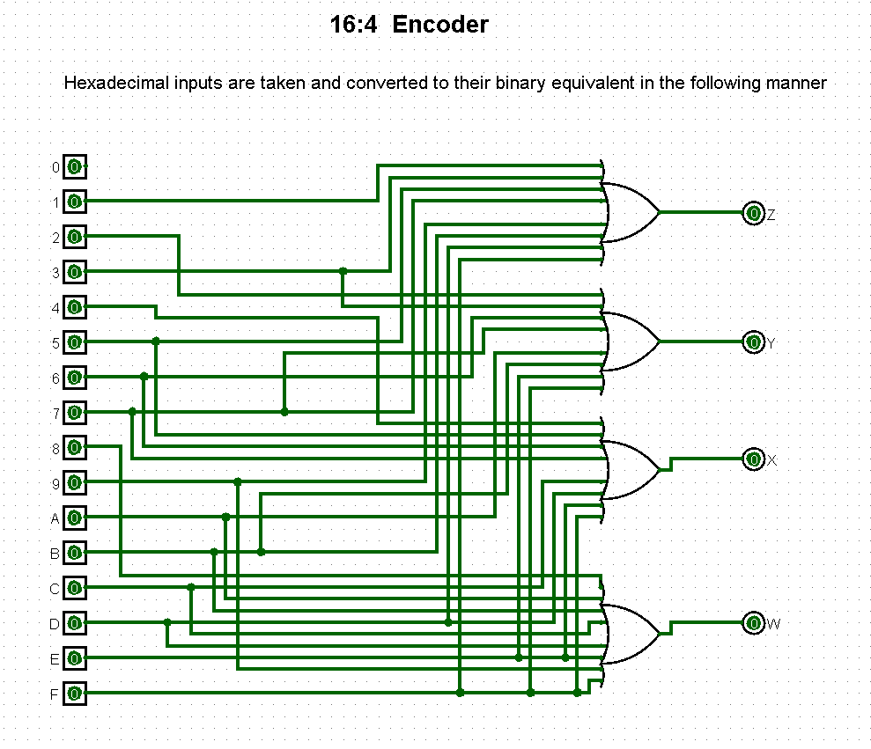
16:4 Encoder
1

Slide 7
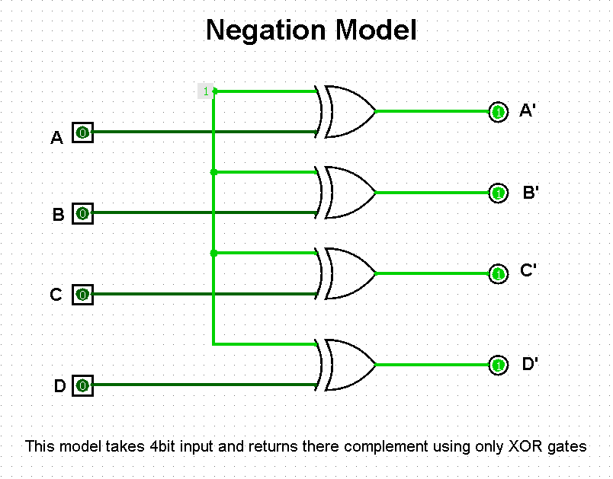
Negation
1

Slide 8
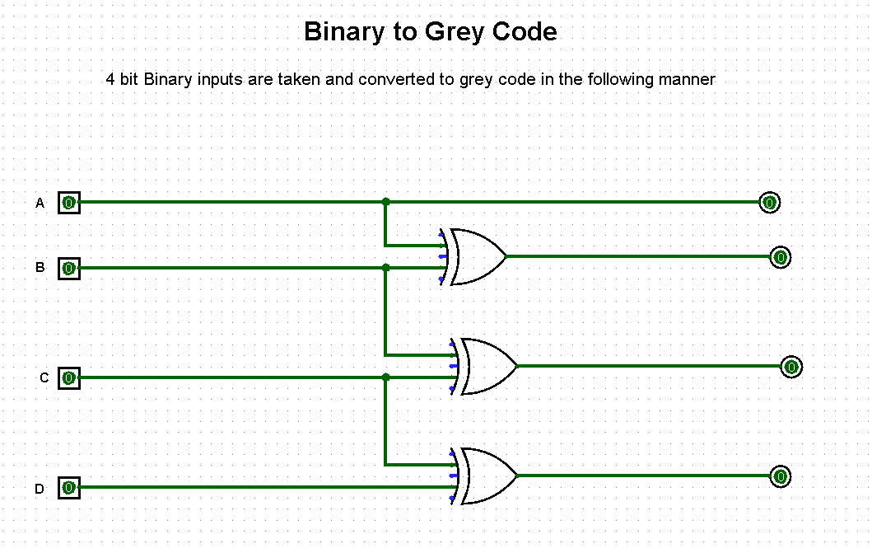
Binary to Grey Code Convertor
1

Slide 9
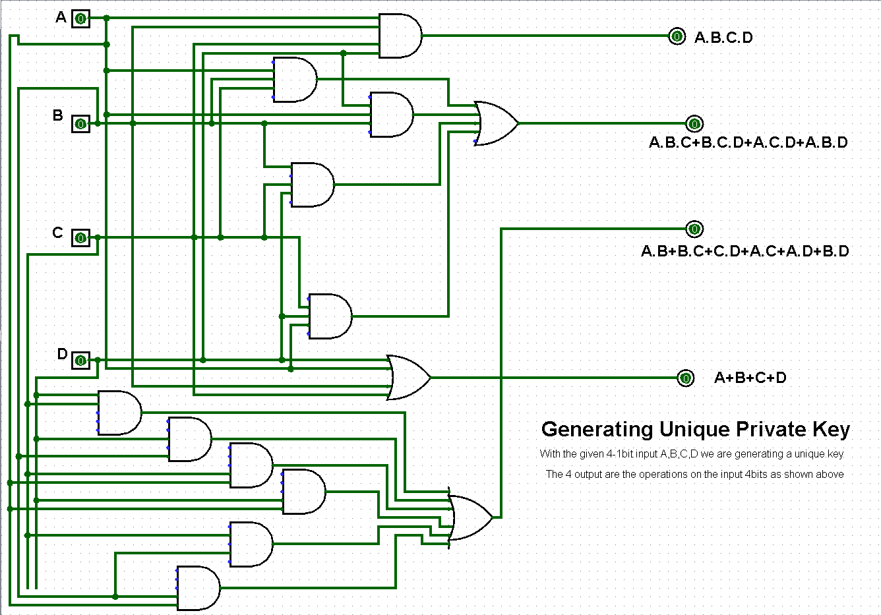
Private Key Generator
1

Slide 10
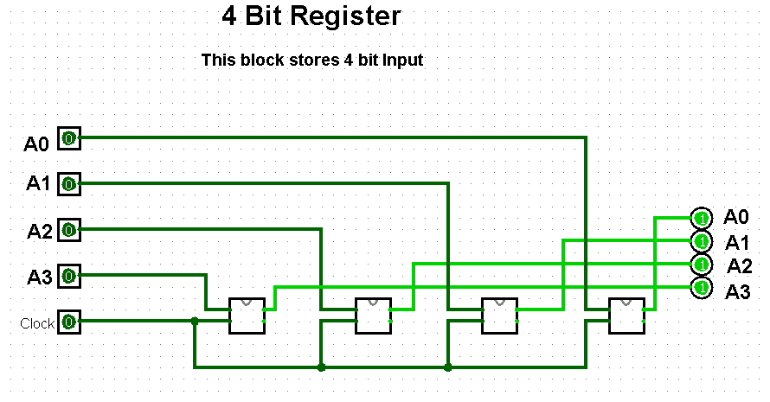
4 Bit Register
1

Slide 11
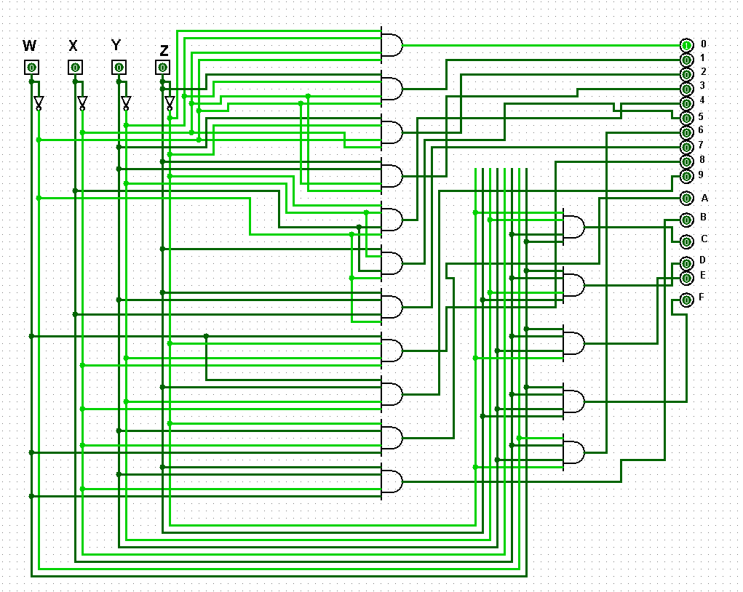
4:16 Decoder
1

Slide 12
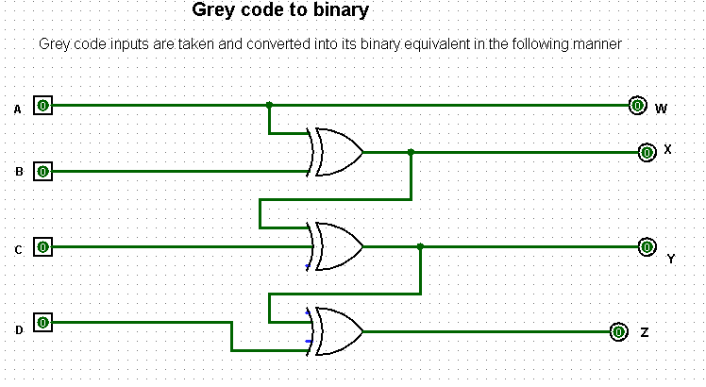
Grey Code to Binary Convertor
1

Slide 13
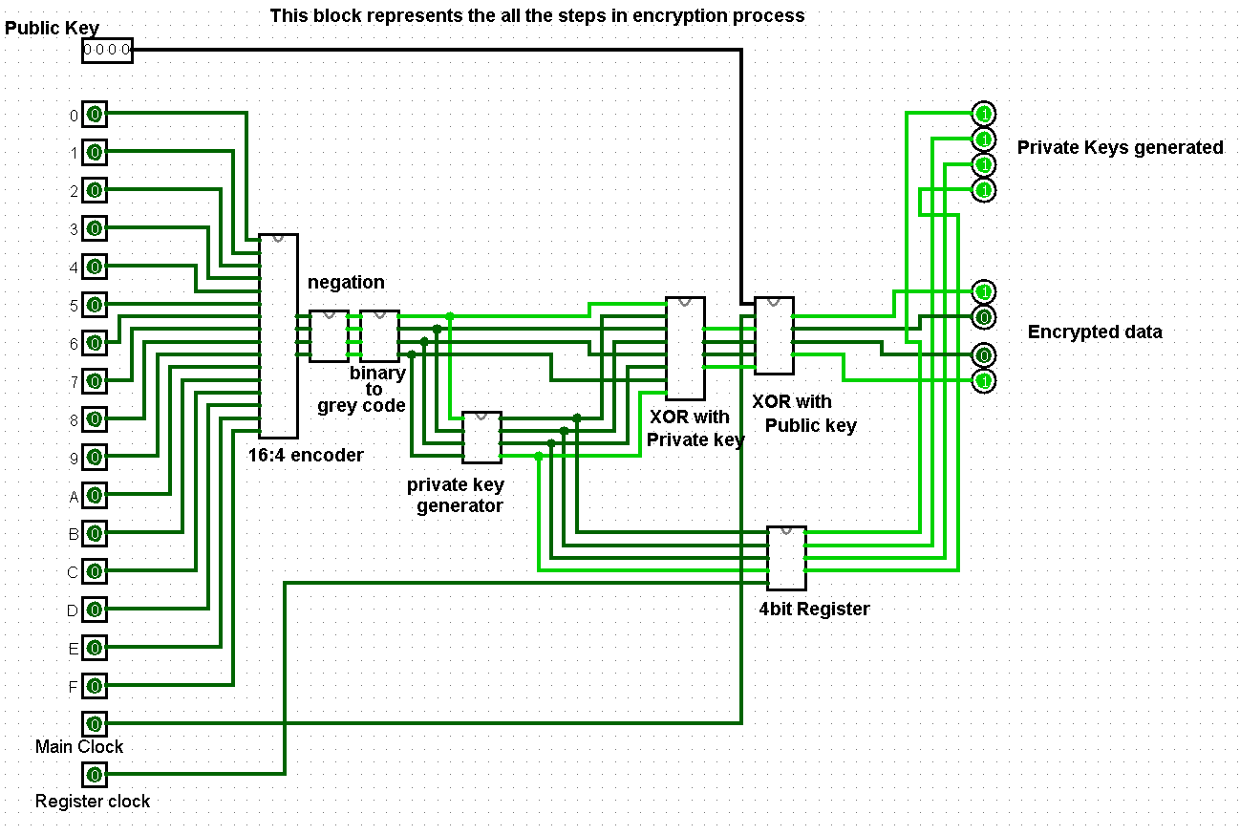
1 bit encryption model
1

Slide 14
Explaining
1
🠺
🠺
Here firstly the public key is set by the user and then 1 bit input is fetched from the user. As it is hex so the input falls between 0-F. Then the input is passed to encoder which converts it to binary then the negation block complements the binary and further converted to grey code
The grey code is used to make the private key by converting each bit into an equation. After the private key generation it is stored in a 4 bit register and XORed with the message further it is XORed with the public key and the Encrypted Data is formed.

Slide 15
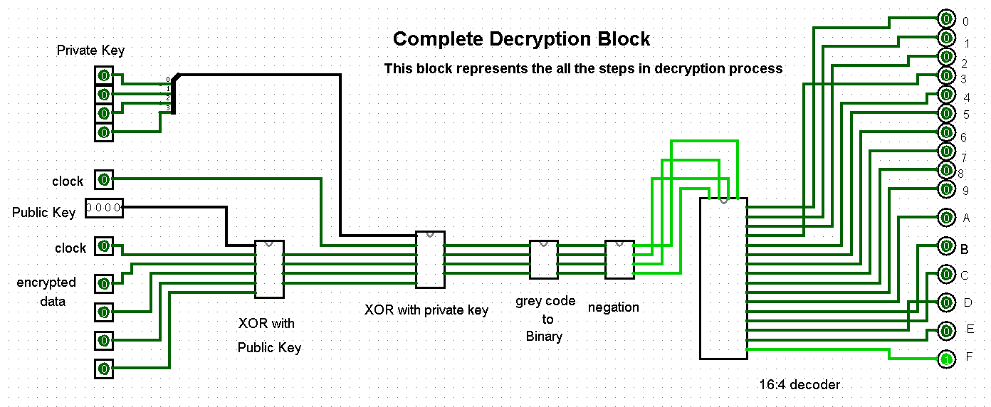
1 bit decryption model
1

Slide 16
Explaining
1
🠺
🠺
Here firstly the private key is set by the user and then encrypted data input is fetched from the user. As it is binary so the input is 0-1. Then the input is passed to be XORed with the public key which is then XORed with the private key and the grey code converts it to binary then the negation block complements the binary.
Then the Binary is passed through a Decoder which converts it to the HEX as the decrypted message.

Slide 17
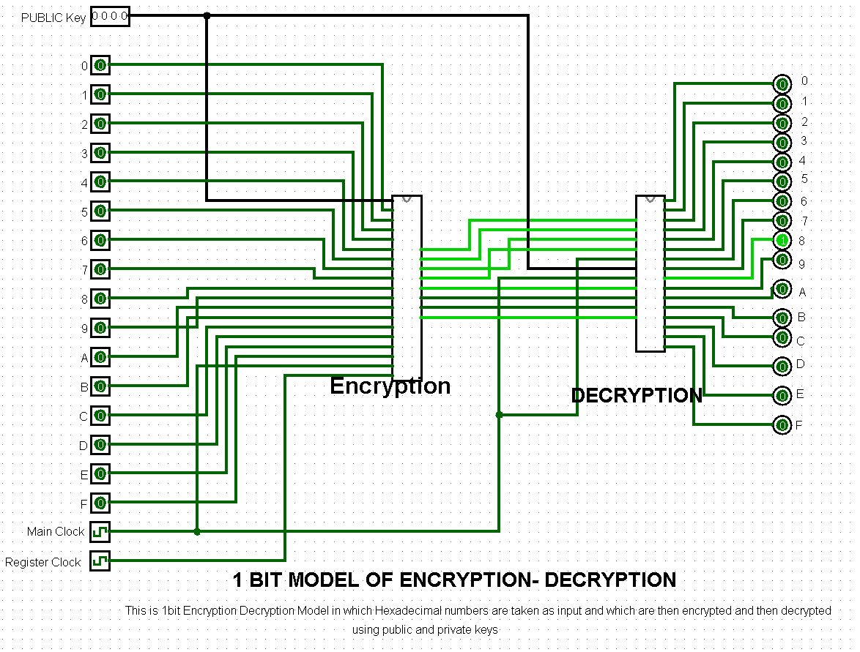
1 Bit Encryption-Decryption
1

Slide 18
Explaining
1
🠺
🠺
This is 1 Bit Encryption-Decryption Model in which Hexadecimal numbers are taken as input and which are then encrypted and then decrypted using the public and private keys

Slide 19
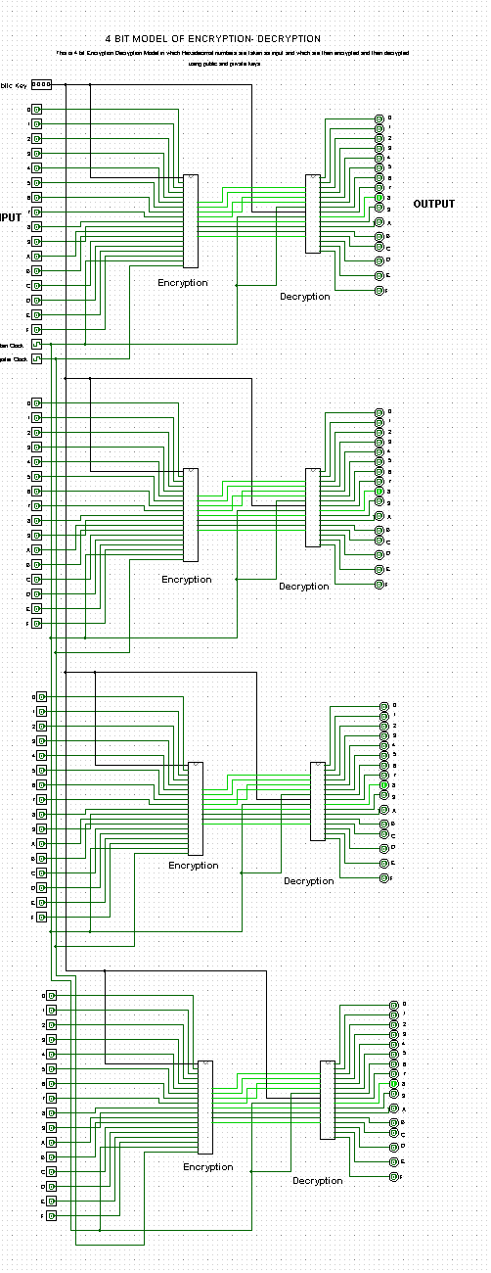
4 Bit Encryption-Decryption
1
Explaining
Here in this circuit all the process is done as the same done in 1 bit encryption-decryption circuit but the only difference is here 4 bits work simultaneously and only 1 pair of private and public key is used among the all 4 bits.

Slide 20
Summarization
1
In such a way we achieved encryption of 1 Hexadecimal message to decryption of 1 bit Hexadecimal
So now by integrating the 1 bit encryption-decryption circuit 4 times now we can successfully encrypt and decrypt 4 bit Hex message

Slide 21
1
Thank you

